Slide 1
스레드 개수 | Lock Free Stack | Backoff Stack | BO smaller spin | Elimination Backoff Stack | Improved Elimination Stack | Imp EL 1ms
1 | 219ms | 216ms | 230ms | 226ms | 211ms | 210ms
2 | 242ms | 201ms | 215ms | 221ms | 226ms | 180ms
4 | 414ms | 199ms | 250ms | 369ms | 394ms | 208ms
8 | 716ms | 204ms | 345ms | 689ms | 789ms | 527ms
16 | 1702ms | 231ms | 1017ms | 933ms | 1700ms | 975ms

Slide 3
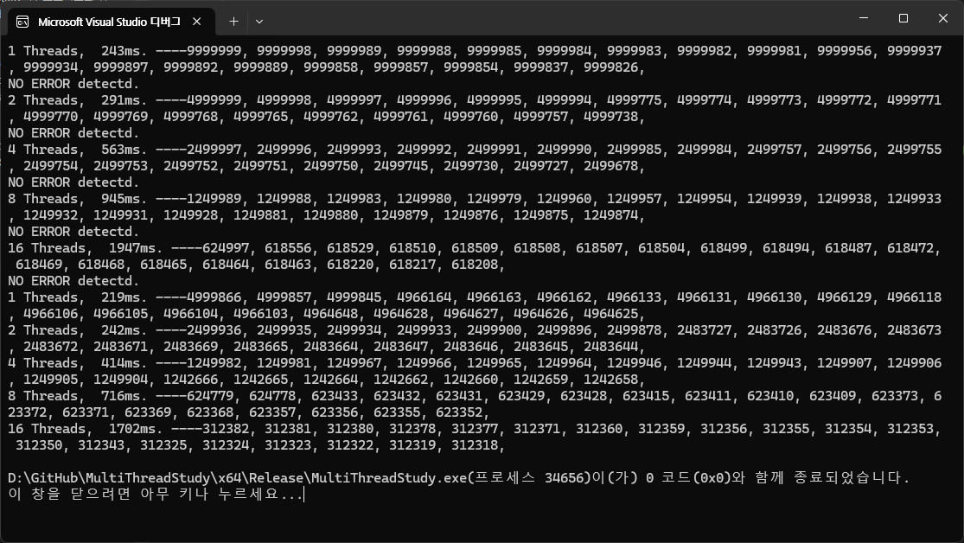
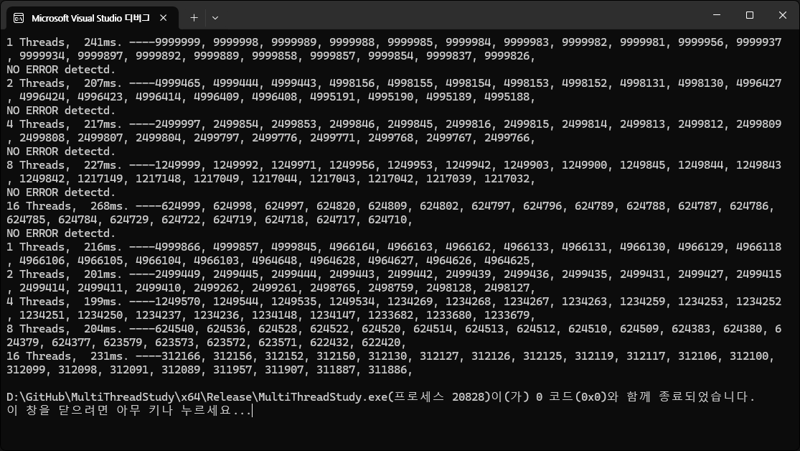
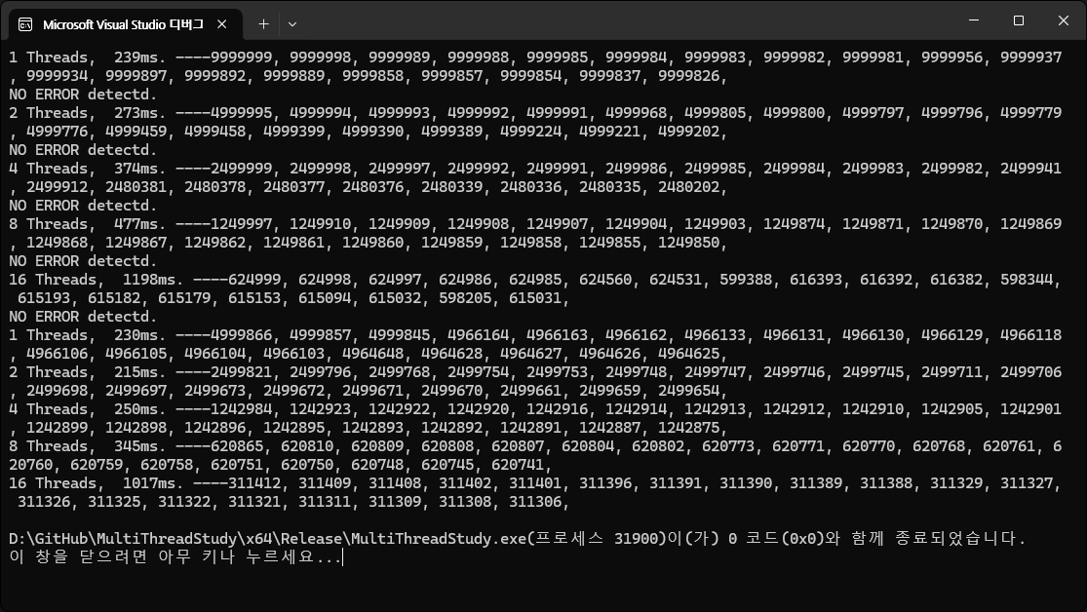
LF 결과
BO 결과
BO 결과
constexpr int MAX_SPIN = 1 << 16; constexpr int MIN_SPIN = 1 << 8;
constexpr int MAX_SPIN = 1 << 8; constexpr int MIN_SPIN = 1 << 4;

Slide 4
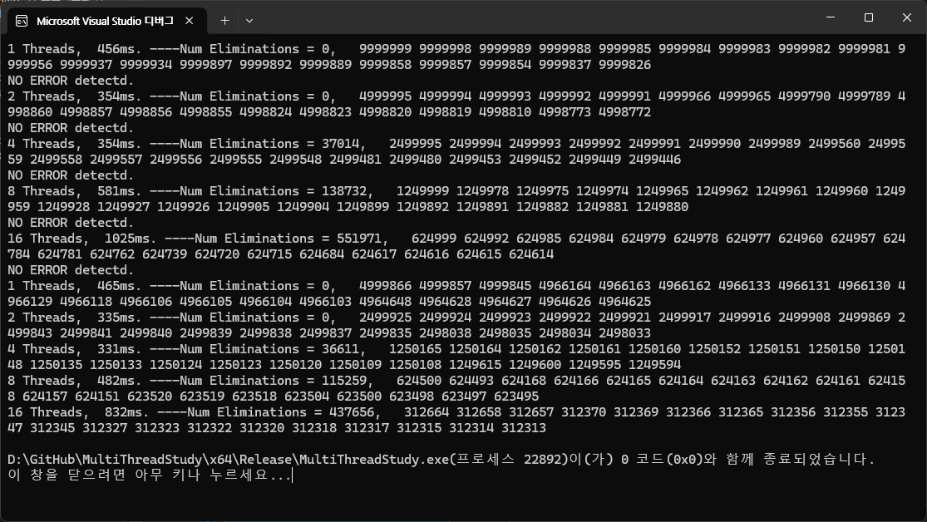
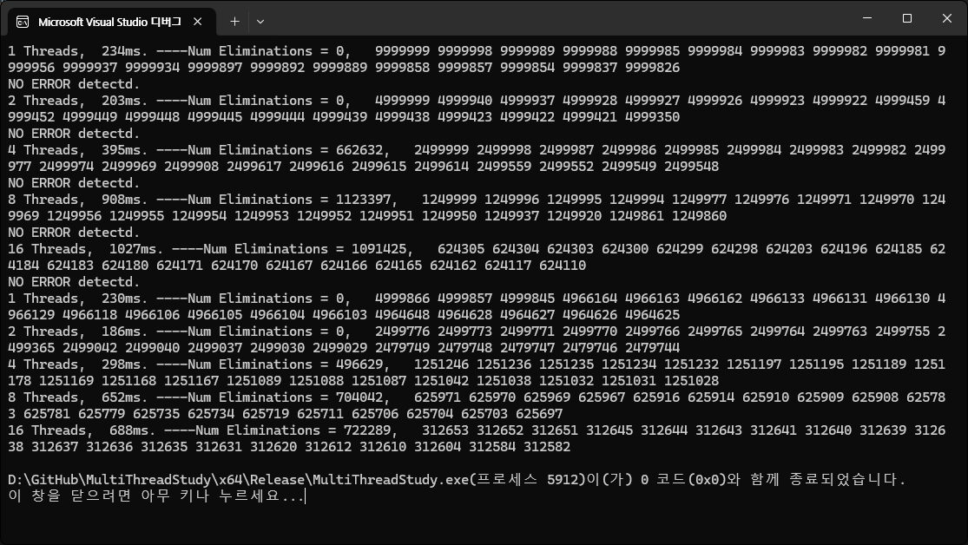
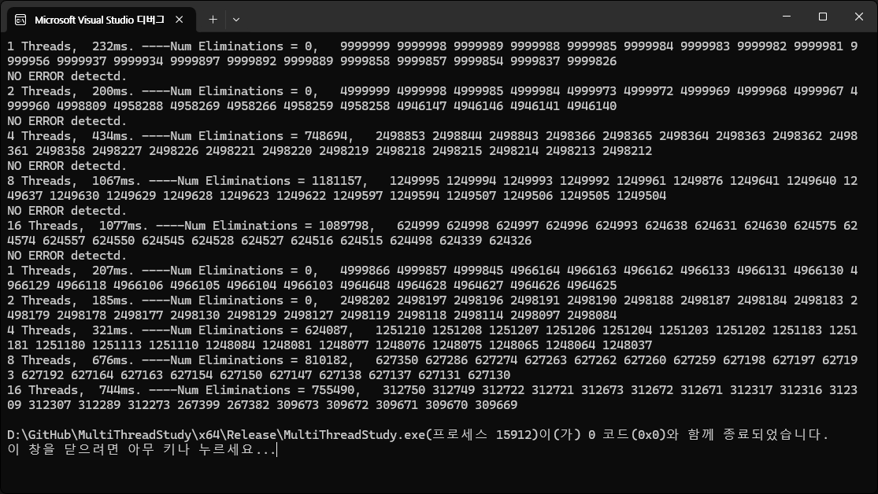
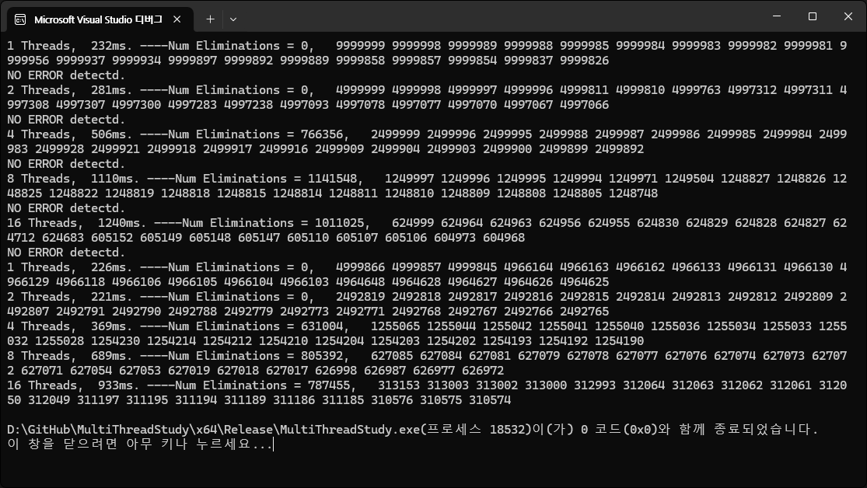
A Scalable LF Stack Algorithm
new 오버헤드 존재
Exchagner Elimination
constexpr int MAX_SPIN = 1 << 16; constexpr int MIN_SPIN = 1 << 8;
constexpr int MAX_SPIN = 1 << 12; constexpr int MIN_SPIN = 1 << 6;
constexpr int MAX_SPIN = 1 << 8; constexpr int MIN_SPIN = 1 << 4;

Slide 5
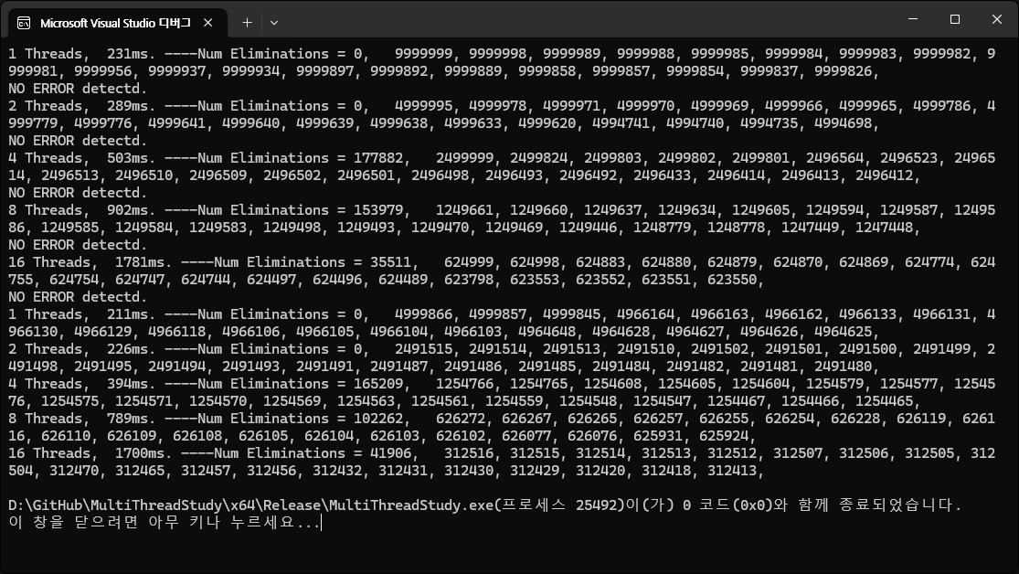
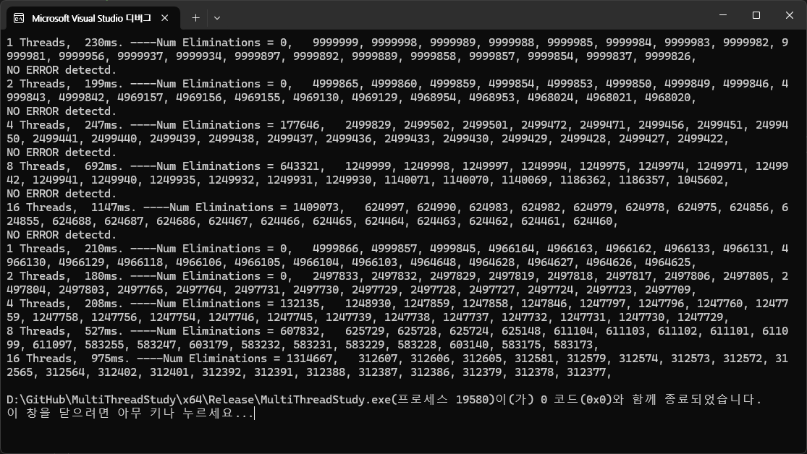
Improve Elimination Stack
An improved implementation of the elimination
10ns
1ms

